Slide 1














Elevator Case study
Presented by Group 1

Slide 2
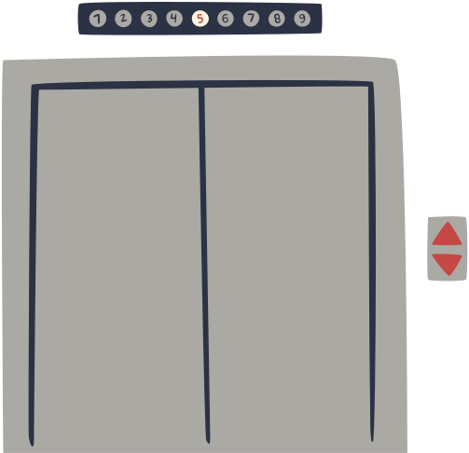
Problem Statement
The Elevator Management System aims to efficiently control multiple elevators in a building with multiple floors. Each elevator has buttons for each floor and responds to up/down requests from floors. When a user requests an elevator, it arrives at the floor and takes them to their destination. The system must handle normal scenarios where users request elevators to travel between floors and exception scenarios where multiple users have conflicting destination requests.

Slide 3
Tech Stack
Programming Language
Integrated Development Environment (IDE)
Version Control
Testing
Python
Visual Studio Code (VS Code)
Git
Pytest

Slide 4
Functional Requirements
Elevator Movement: The system must facilitate the movement of elevators between floors in response to user requests.
User Request Handling: Users should be able to request an elevator from any floor and specify their destination floor.
Button Illumination: Elevator buttons must illuminate when pressed to indicate the selected floor or direction.
Floor Button Handling: Floors should have buttons for requesting up or down elevators, which illuminate upon pressing and cancel upon elevator arrival.
Elevator Door Control: The system should control elevator doors, opening them upon arrival at a floor and closing them after a specified timeout.
Elevator Occupancy: The system should manage elevator occupancy, allowing users to enter and exit the elevator at desired floors

Slide 5
Non -Functional Requirements
Reliability: The system should operate reliably under normal and exceptional scenarios, minimizing downtime and system failures.
Performance: Elevator response times should be optimized to minimize wait times for users requesting elevators.
Scalability: The system should be scalable to accommodate increasing numbers of elevators and floors without sacrificing performance.
User Interface: The user interface should be intuitive and user-friendly, allowing users to easily request elevators and navigate between floors.
Security: The system should incorporate security measures to prevent unauthorized access to elevator controls or tampering with elevator operations.
Accessibility: The system should be accessible to users with disabilities, providing features such as audible cues and tactile buttons for visually impaired users.

Slide 6
Design Models
Sequence diagram

Slide 7
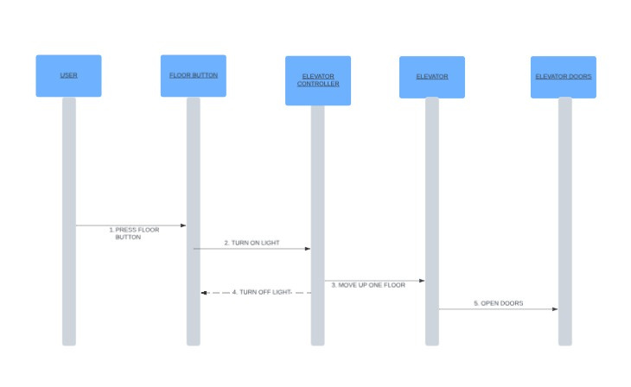
Sequence Diagram for Floor Button

Slide 8
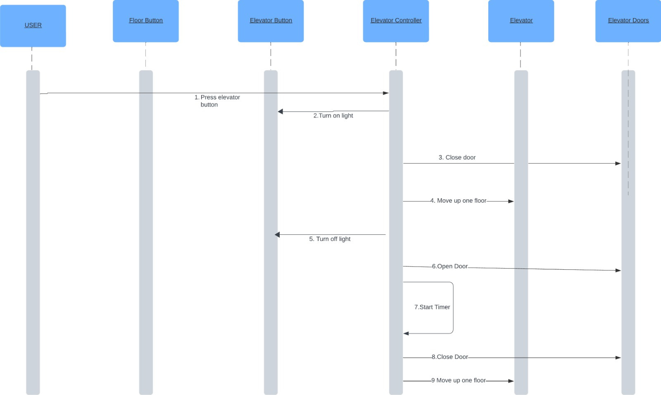
Sequence Diagram for Elevator Button

Slide 9
Project Management
Followed Agile Methodology
Utilized Jira for Sprint Planning

Slide 10
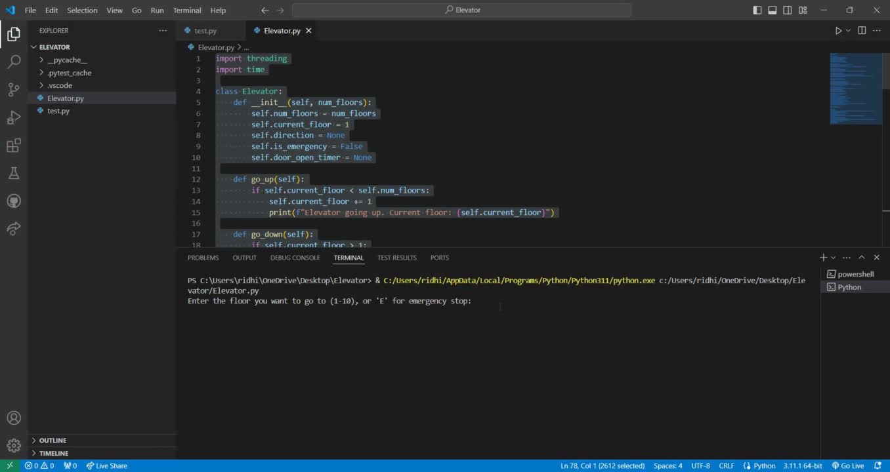
DEMO

Slide 11
GIT Link:
ElevatorCaseStudy

Slide 12
Risks
Limited Error Handling: The code lacks comprehensive error handling, especially when it comes to user inputs. Invalid inputs or unexpected errors during elevator operation may cause the program to terminate unexpectedly.
Synchronous Timers: The timer functionality implemented using threading.Timer may not be suitable for scenarios where the elevator system needs to handle multiple events concurrently. Synchronous timers may block the main thread, causing delays or performance issues.
Global State Management: The Elevator class maintains global state variables such as current_floor, direction, and is_emergency. This may lead to unpredictable behavior, especially in multi-threaded environments, where concurrent access to shared state can result in race conditions or data corruption.
Limited Test Coverage: The code lacks comprehensive unit tests to verify the functionality of individual components and edge cases. Without adequate test coverage, it's challenging to ensure the correctness and reliability of the elevator system.

Slide 13
Solutions
Error Handling: Implement robust error handling mechanisms to handle invalid inputs, unexpected exceptions, and edge cases gracefully. Use try-except blocks to catch and handle errors, providing informative error messages to users.
Asynchronous Timers: Consider using asynchronous timers or event-driven architectures to handle timer events asynchronously. Asynchronous programming models such as asyncio or concurrent.futures can help improve the responsiveness and scalability of the elevator system.
Encapsulation and State Management: Encapsulate the elevator's state and behavior within a class, employing proper encapsulation techniques such as encapsulating state variables and providing well-defined interfaces for interacting with the elevator system. Consider using locks or synchronization primitives to manage concurrent access to shared resources safely.
Unit Testing: Develop comprehensive unit tests to verify the correctness and reliability of the elevator system's components. Write test cases to cover various scenarios, including valid inputs, invalid inputs, boundary conditions, and edge cases. Use testing frameworks such as pytest or unittest to automate the testing process and ensure thorough test coverage.

Slide 14
Learning Outcomes
Project Management Skills
Problem-Solving Abilities
Collaboration and Teamwork
Attention to Detail
Critical Thinking and Decision-Making
Communication Skills
Adaptability and Flexibility
Creativity and Innovation

Slide 15
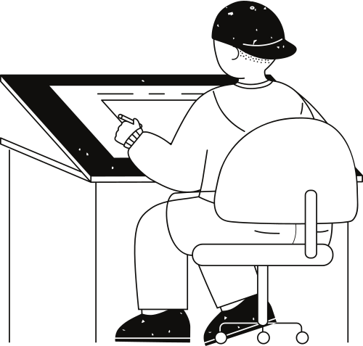




Swetha:
Developer
Soumya :
Team Leader
Project Manager
Roles and Responsibiities
Ridhi:
Developer
Nikhila:
Quality Assurance Analyst

Slide 16
Thank you very much!

